Slide 1
LOS ANGELES – VISION ZERO
Haridut Athi, Rui Hu, Yanning Li
FACULTY SPONSOR: Prof. Richard Sowers
University of Illinois, Urbana-Champaign

Slide 2
VISION ZERO – LOS ANGELES
Los Angeles has set its sights on zero traffic fatalities by 2025 through the initiative “Vision Zero”. The fact that more than 200 people are killed every year trying to move around the city is motivation enough for such an initiative
This effort brings together transportation engineers, police officers, advocates, and policymakers to work together towards creating safer streets. The focus will be protecting the most vulnerable road users, including children, older adults, and people walking and bicycling.
Vision Zero has a proven track record in many cities across the world
Los Angeles Department of Transportation have put together the collision data for the years 2009-2013 and intend to add more data in the near future

Slide 3
MEET THE DATA
The goal of our analysis is to zero down on the factors that most possibly lead to a fatality and apply machine learning techniques to predict circumstances that most likely lead to a road fatality. Los Angeles transportation department has made public their collision dataset for the years 2009-2013. The details of the victims and the vehicles are also elaborately listed in separate datasets.
The dataset utilized for the analysis contains 173714 instances of collisions from the year 2009 to 2013 with only 875 instances resulting in a fatality ( 0.5% ).
There are 89 attributes available in the collisions data, 12 attributes that throw light about the victims and 35 attributes that talk about the party or vehicle involved.
We could relate between different tables using a common-key ‘Case-ID’ found in all datasets.

Slide 4
OVERVIEW OF THE ATTRIBUTES
DATE & TIME : Year, Month, Day, Time
LOCATION: Latitude and Longitude, Primary Road, Secondary Road, Intersection or not
INJURIES/FATALITIES: Number killed, Number injured, Pedestrians killed and injured, motorists killed and injured, bicyclists killed and injured, severity of injury
CONTRIBUTING FACTORS: Primary collision factor, Lighting condition, Road condition, Alcohol consumption, Preceding action before collision, Pedestrian action during collision
VICTIM INFORMATION: Age, Sex, Victim role, Victim seating position, Severity of injury
PARTY INFORMATION: Vehicle type, Party’s alcohol history, Movement preceding collision, Inattention details

Slide 5
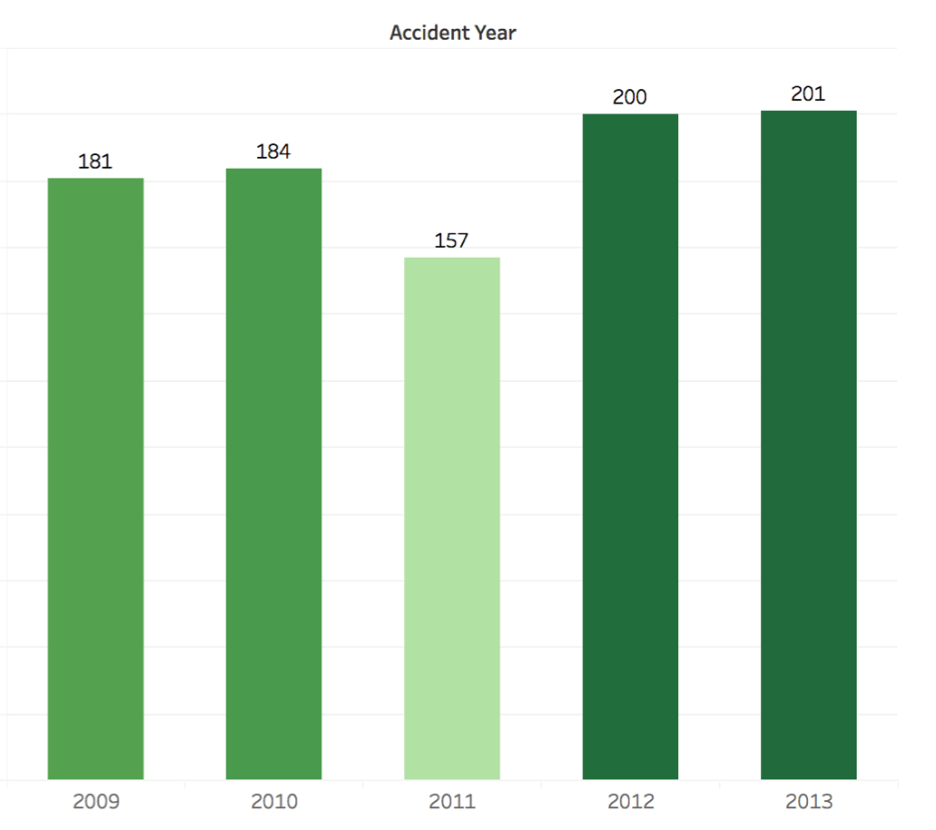
ANNUAL TRAFFIC FATALITIES TREND
The gradual increase in fatalities explains why the authorities had to implement ‘Vision Zero’ in 2015

Slide 6
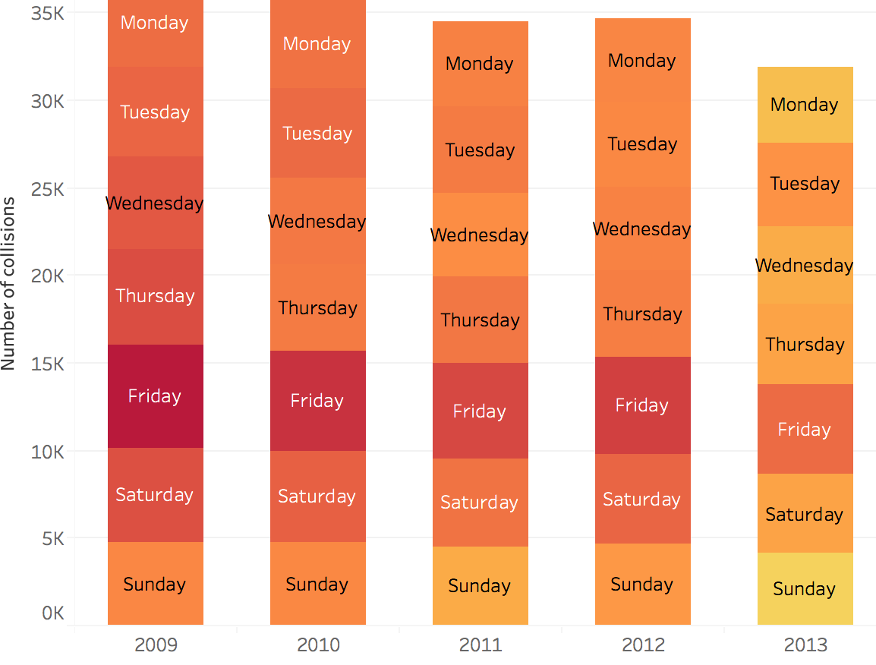
FRIDAY RECORDS THE MOST COLLISION EACH YEAR

Slide 7
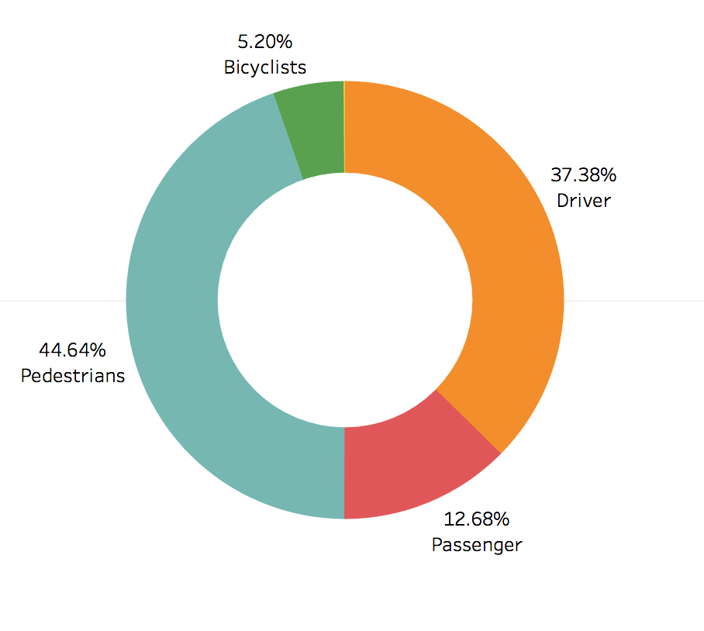
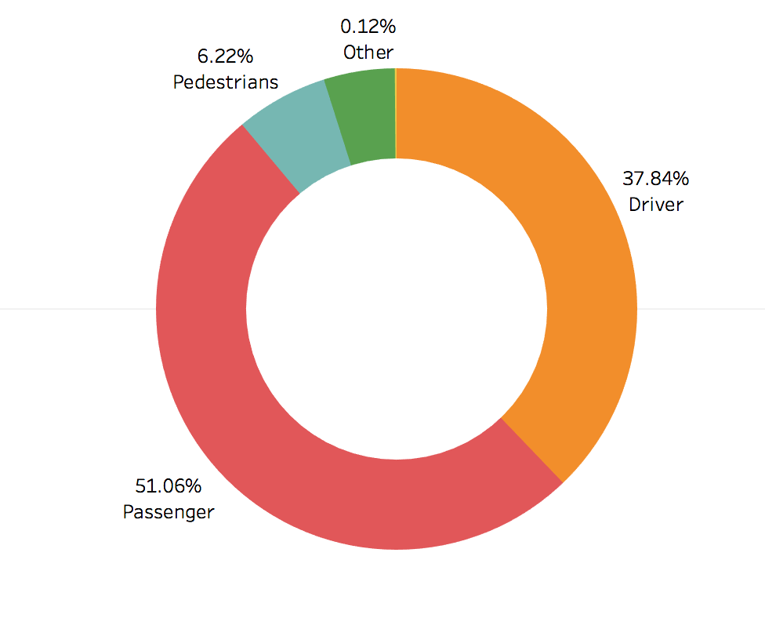
SPOTLIGHT ON PEDESTRIANS
Though only 6.2 % of the collisions involved pedestrians, the pedestrian fatality constitutes 44.6% of the total fatalities.
COLLISIONS BASED ON TRAVEL MODE
FATALITIES BASED ON TRAVEL MODE

Slide 8
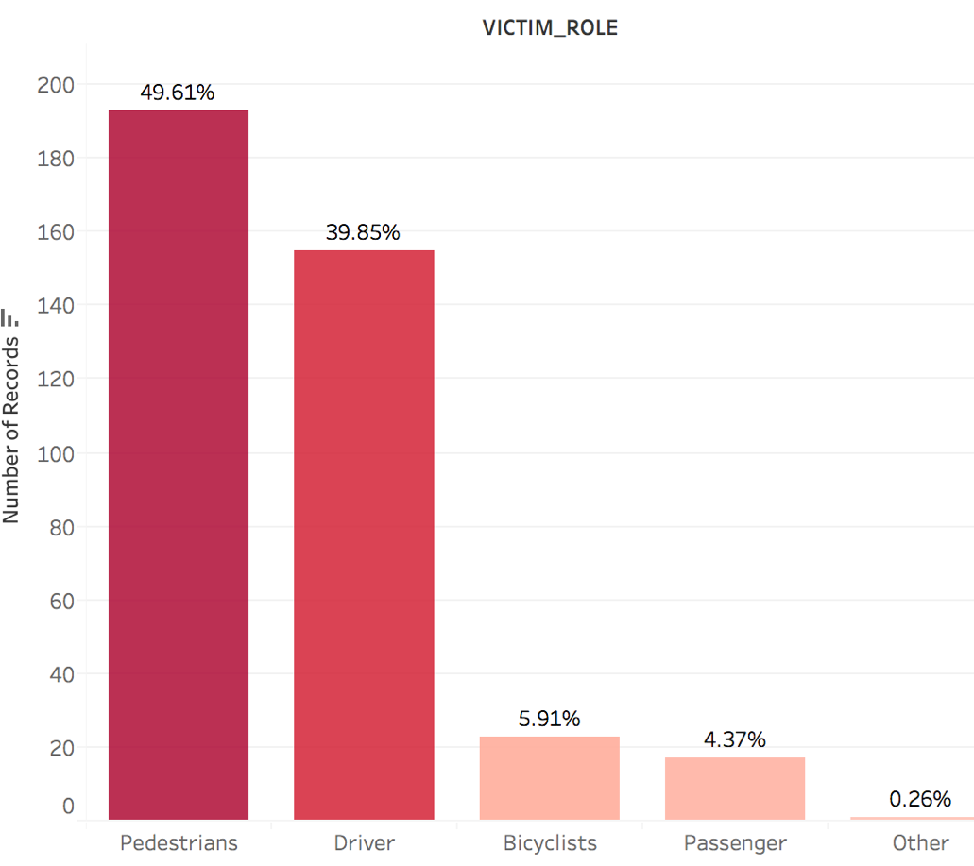
LOSING YOUNG LIVES
One more motivation to look at pedestrian fatalities is the fact that among the young people (0 to 30 years) of Los Angeles, a half of the fatalities occur when the mode of travel is walking

Slide 9
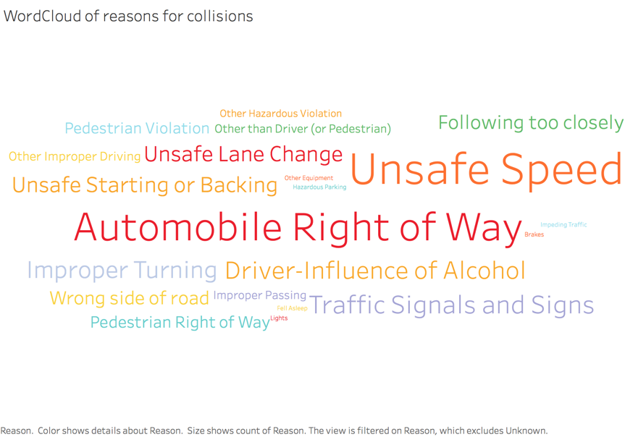
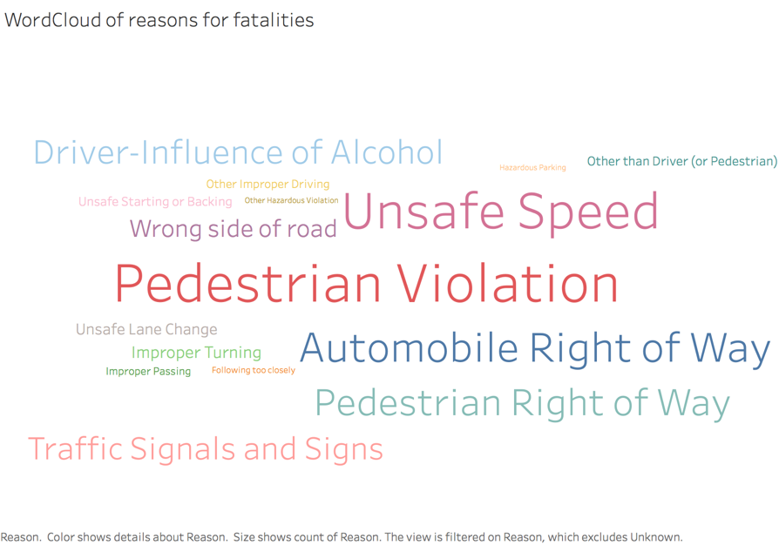
REASONS FOR COLLISIONS AND FATALITIES
While Unsafe Speed seems to be the primary reason for collisions, Pedestrian violation seems to be the primary
reason for fatalities.

Slide 10
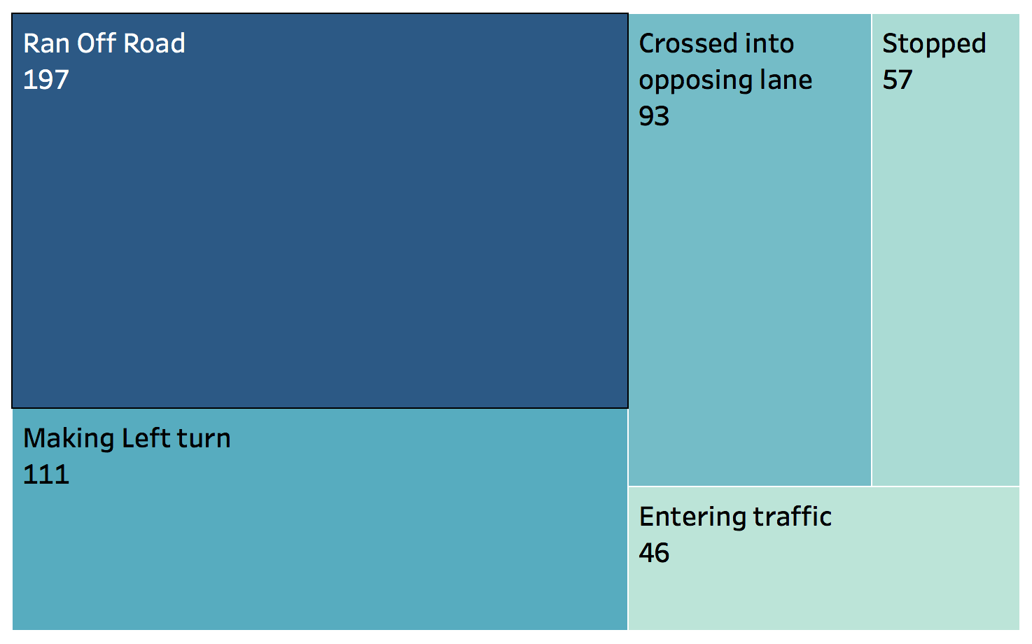
PRECEDING ACTION BEFORE FATALITY

Slide 11
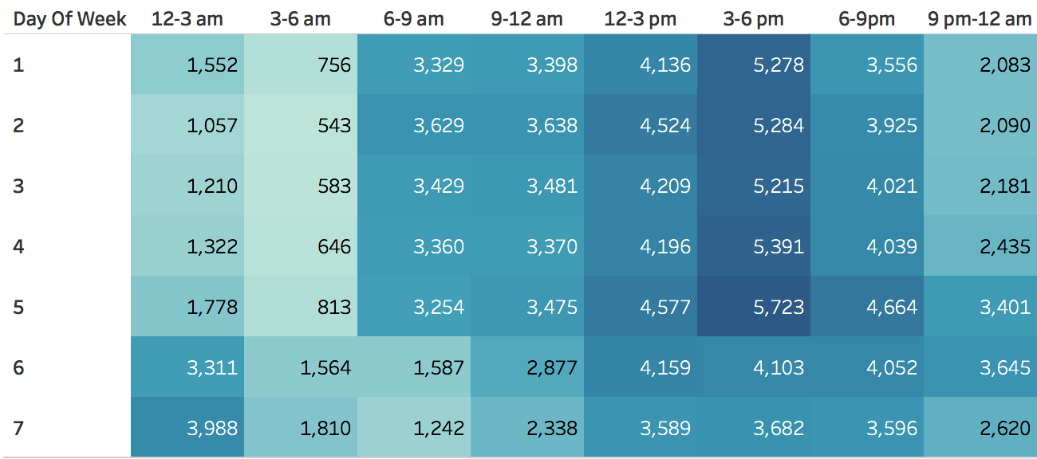
MORE COLLISIONS DURING PEAK HOURS ?
An interesting pattern to observe is that throughout the weekdays most collisions take place from 3 to 6 pm. This can be attributed to the fact that most people might be returning from office and children from school .
There seems to be a spike in the number of incidents during the weekends during midnight.

Slide 12
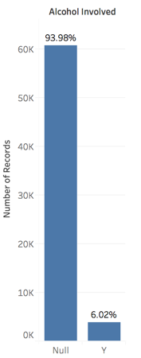
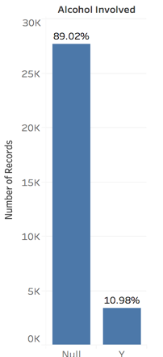
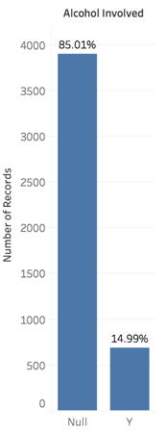
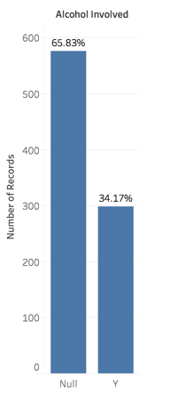
DOES ALCOHOL HAVE A ROLE TO PLAY ?
Visible injury
Complaint of pain
Though the percentage of incidents involving alcohol is lower compared to the ones not involving it, there is a striking increase in alcohol involvement along with the severity of the injury.
Fatal injuries had 34.2 % alcohol involvement while minor injury had only 6% involvement
Severe
Fatal

Slide 13
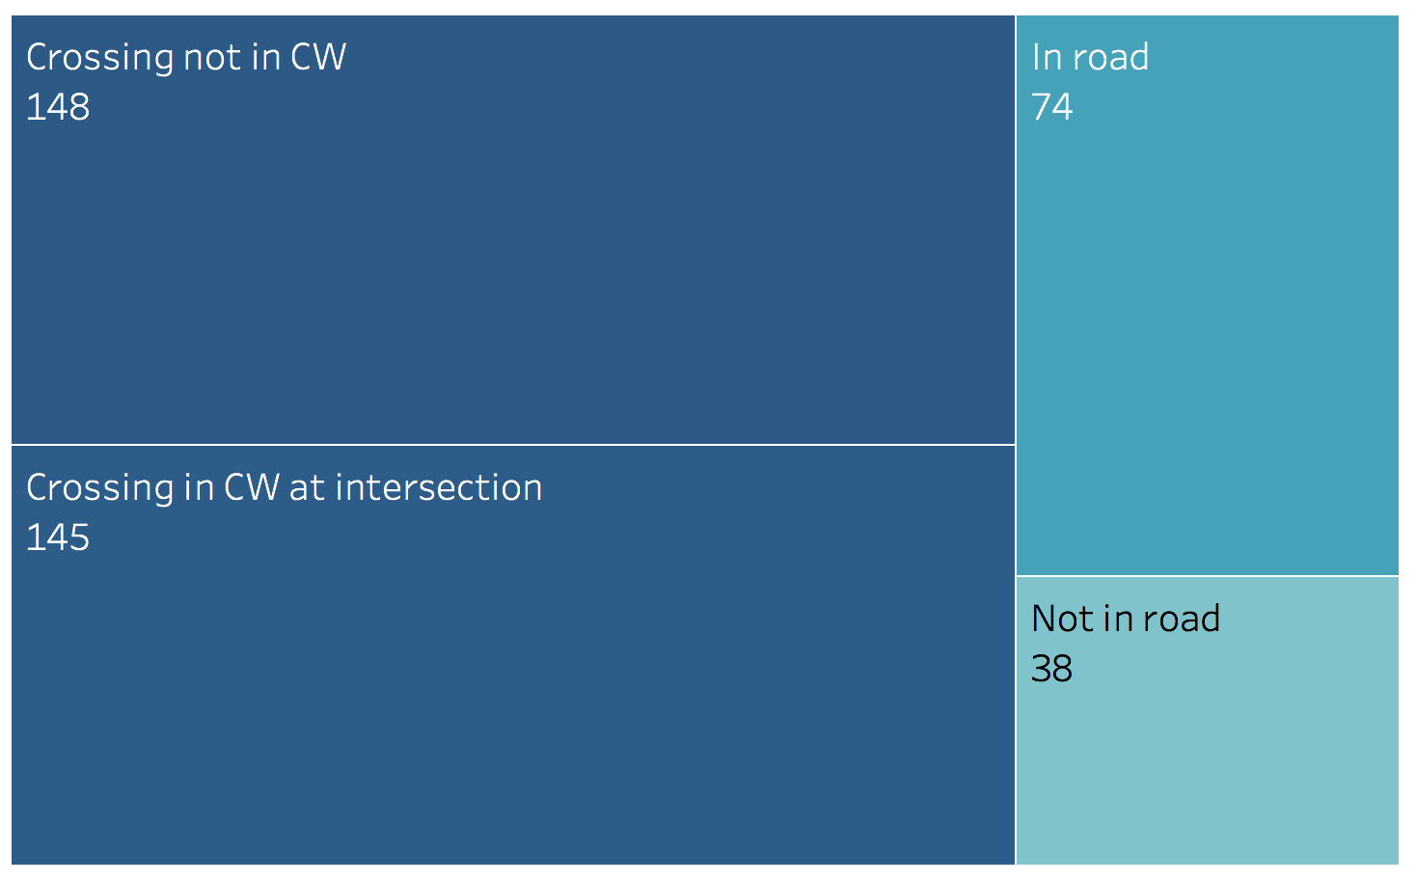
PEDESTRIAN ACTION DURING FATALITIES
Looking at the what the pedestrians were doing during fatal collisions, it turns out that most of them were either crossing roads not in the crossway or crossing roads in the crossway at intersections

Slide 14
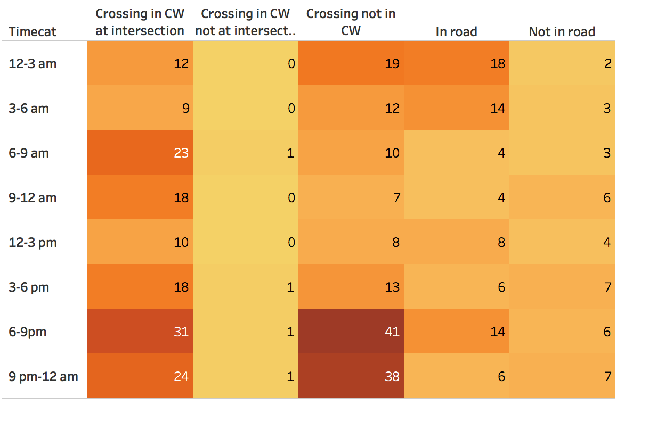
COMBINED INFLUENCE ON TIME AND PEDESTRIAN’S ACTION ON FATALITY
We decided to look if there was any specific combination of time and pedestrian’s actions that stood out compared to the rest when it came to fatalities.
It does not come as a surprise that most of the pedestrian fatalities occur when pedestrian crosses the road not in the crosswalk between 6 to 9 pm.
One possible reason could be that motorists often don’t expect people to cross in the middle of the road and this get doubly dangerous in darker roads

Slide 15
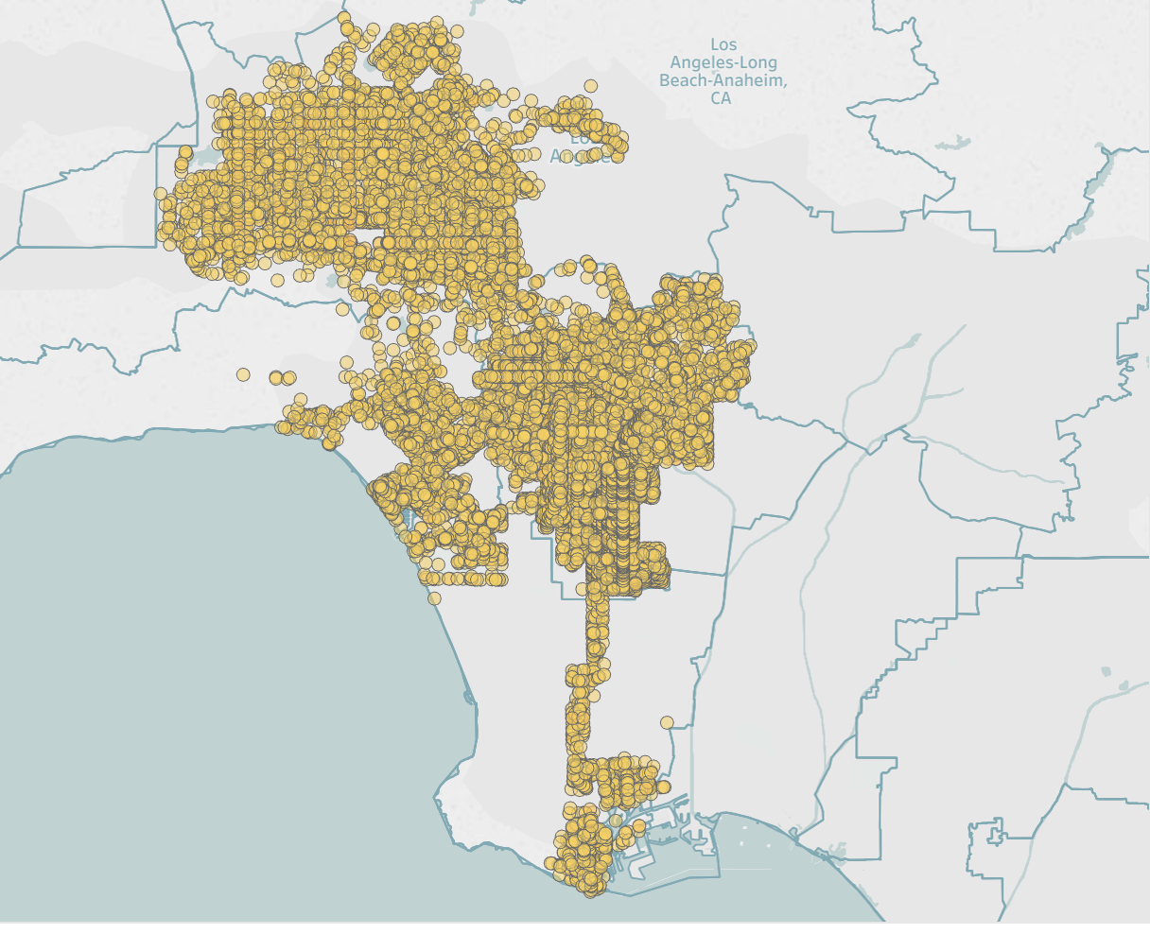
COLLISION VISUALIZATIONS FOR 2013

Slide 16
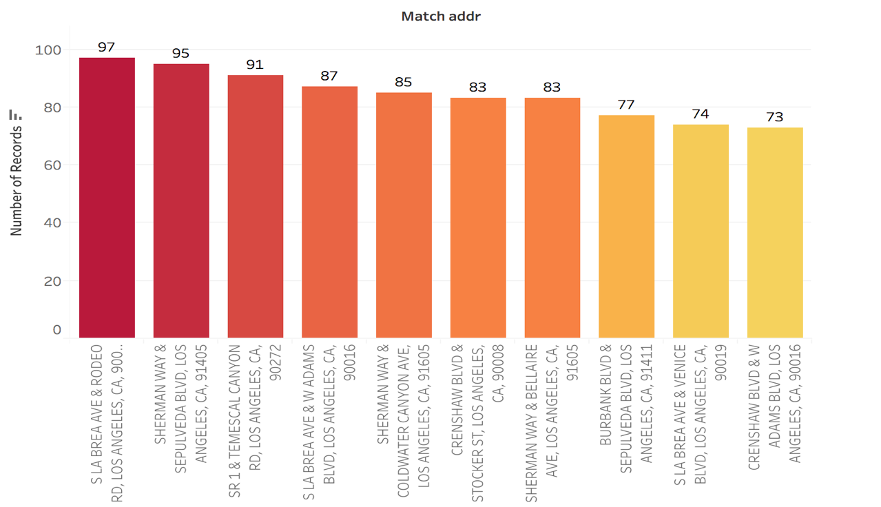
TOP 10 COLLISION SPOTS

Slide 17
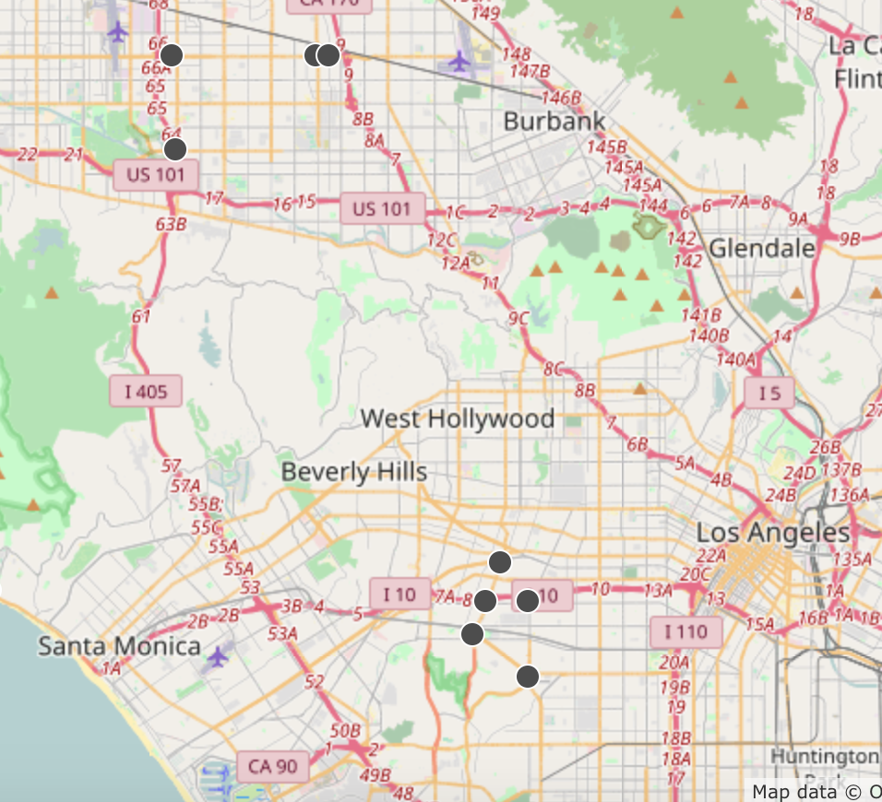
MORE COLLISIONS NEAR AIRPORT
Three of the top 10 collision spots are on the lane connecting Van Nuyes airport and Bob Hope airport.
One possible reason could be people rushing to catch connecting flights from one airport to the other.
Unsafe speeds and Automobile right of way are the primary reasons for collisions at these spots too.

Slide 18
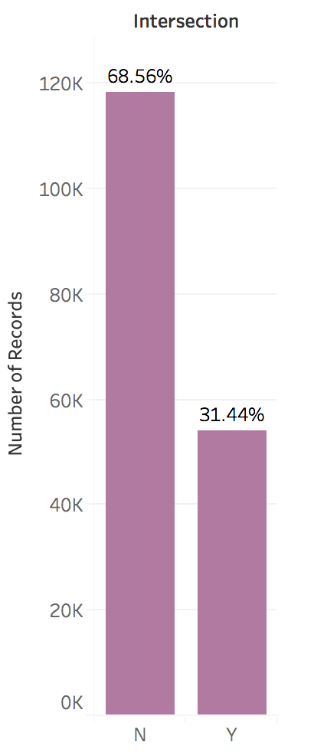
MORE COLLISIONS AT INTERSECTIONS ?
More collisions occur at non-intersections than at intersections, with only 31 % at intersections.
Though the number of collisions at the intersections are outweighed by the collisions at non-intersections, half of the top 10 collision spots happen to be intersections

Slide 19
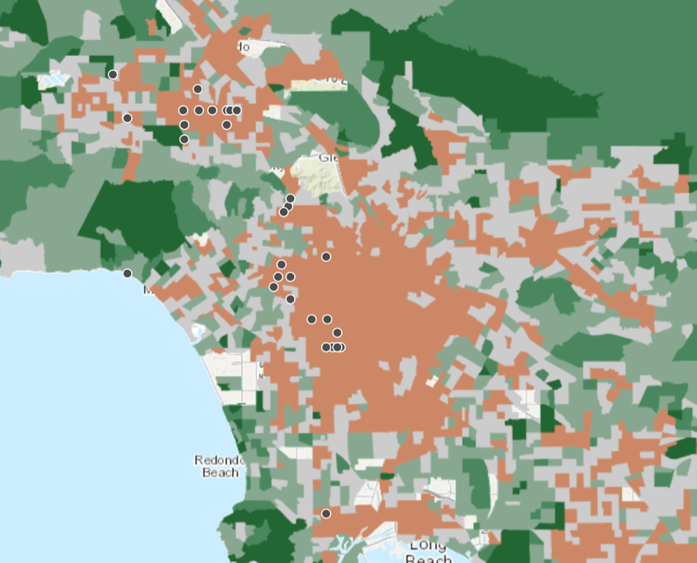
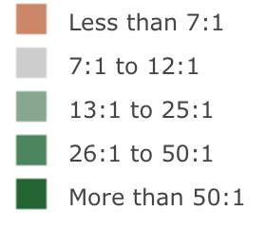
HOW DOES COLLISION RELATE TO POVERTY RATIO?
Poverty ratio considered here is the number of households above poverty line for every household below poverty line
We decided to study if the top collision spots were in someway related to poverty.
It turns out that most of the top 30 collision spots took place in the region were poverty ratio was the worst ( Less than 7:1 ) which could be an indicator that poverty in some way might contribute to collisions

Slide 20
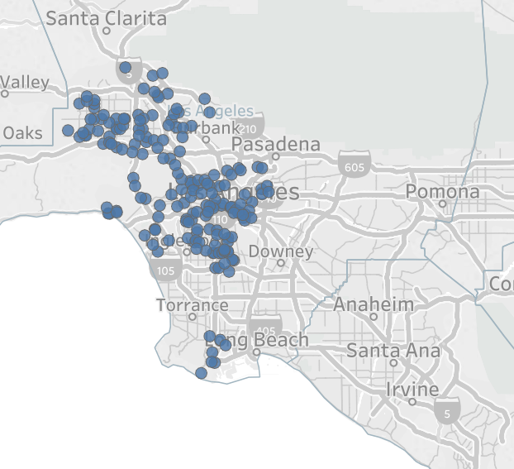
FATALITY VISUALIZATION FOR 2013

Slide 21
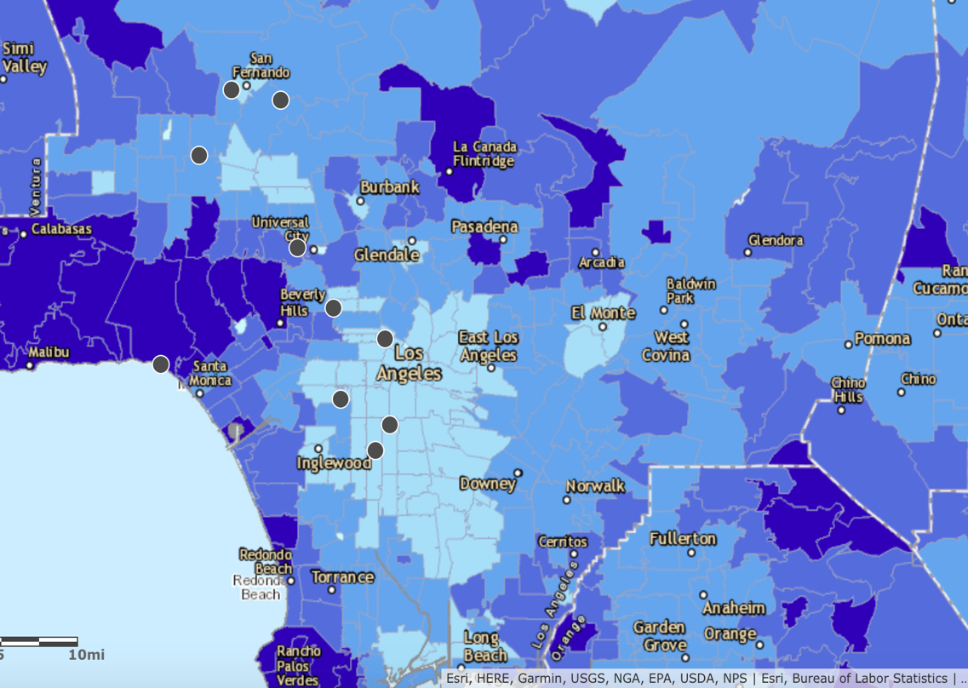
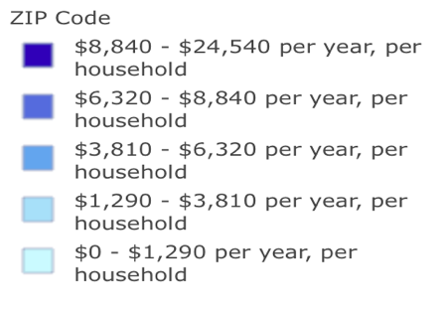
FATALITY AND HEALTH CARE SPENDING
The top 10 spots where fatalities including motorists, pedestrians and cyclists were plotted on top of health care spending per household layers available in ArcGIS
The colors here represent the average healthcare spending per household per year in each zip code.
Interestingly, most of the top 10 fatality spots happen to be in those areas that have the lowest category of health care spending ( $0 - $1290 per year )

Slide 22
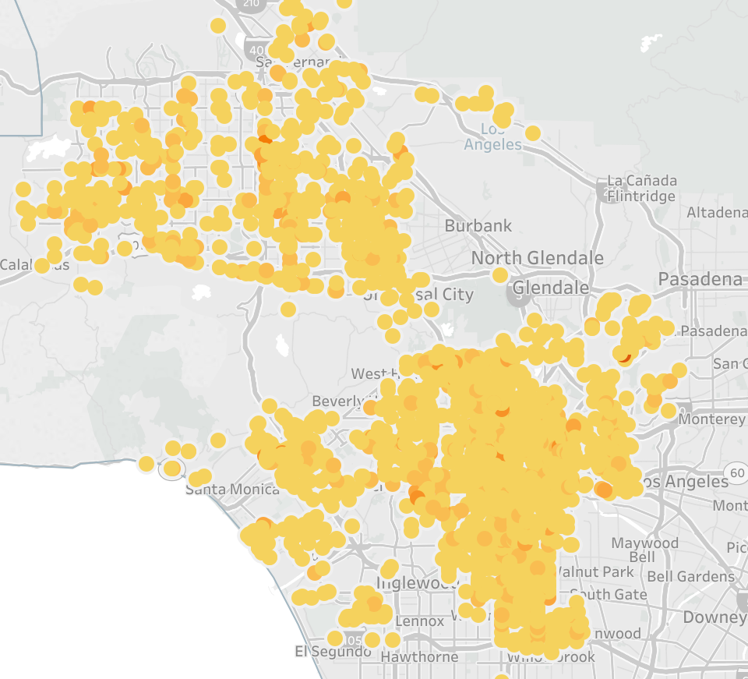
PEDESTRIANS INJURIES AND FATALITIES VISUALIZATION FOR 2013

Slide 23
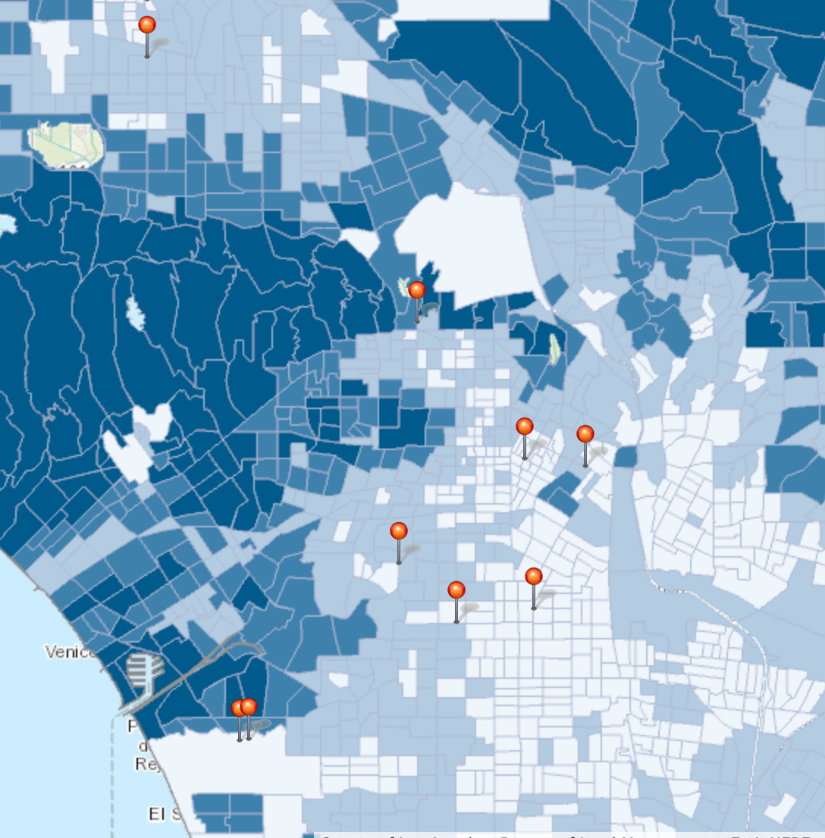
EDUCATION SPENDING AND PEDESTRIAN ACCIDENTS
The US Educational spending per household data from ArcGIS was used to plot the following map. The darker the region more the spending on education.
The top 10 spots where the pedestrians were injured and killed were overlaid on this map.
An interesting pattern that emerged was that none of these top spots happen to be in an area that spends high on education. All these spots fall in the lower bracket of educational spending ($0 -$1850 per year ).

Slide 24
MACHINE LEARNING TO PREDICT FATALITIES
We decided to use machine learning techniques to help predict if a collision would lead to a fatality or not. The objective is that we zero down on the set of events or circumstances that would most most likely result in a collision being fatal.
The features used for our learning algorithms are set of different circumstances that led to a collision and using these features we would be able to figure out which combination of factors contributed heavily to a fatality.
The challenge is to select the best features that would help the learning algorithm predict fatalities with high degree of precision. So, we modeled different learning algorithms to achieve our objective.

Slide 25
THE PROBLEM OF CLASS IMBALANCE
Using Machine learning to predict fatalities within the set of collisions presents a challenge called class imbalance, where one class clearly dominates the other class.
One striking aspect of this data is that there are hardly any fatality instances compared to non-fatalities. In fact, they constitute only 0.005 % of the data, which makes it really hard for the learning algorithm to understand the fatality instances.
Describing the problem of class imbalance in picture
as
Road Activities
Collisions – Our Dataset
Fatalities (0.005%)
- what we predict

Slide 26
SMOTE
Though there are several methods to address this problem , we used a technique called “Synthetic Minority Oversampling Technique” (SMOTE).
SMOTE combines over-sampling of the minority class and under-sampling of the majority class effectively to generate a balanced dataset.
OVERSAMPLING:
The minority class is over-sampled by taking each minority class sample and introducing synthetic minority examples along the line joining any/all of the minority class sample’s K-nearest neighbors.
UNDERSAMPLING:
The majority class is under-sampled by randomly removing samples from the majority class until minority class becomes specified percentage of the majority class.

Slide 27
LOGISTIC REGRESSION TO PREDICT FATALITIES
We trained a logistic regression model with Lasso regularization to predict if a fatality would occur given the circumstances of the collision ( Features ).
Data on Traffic Collisions
Predictive model
Predict fatality given a collision
Time of day
Day of week
Alcohol involved? (y/n)
Accident at an intersection?
Primary Collision factor
Pedestrian’s action
Collision Type
Weather
Lighting
Road condition
Logistic Regression
Did collision result in a fatality? (y/n)?

Slide 28
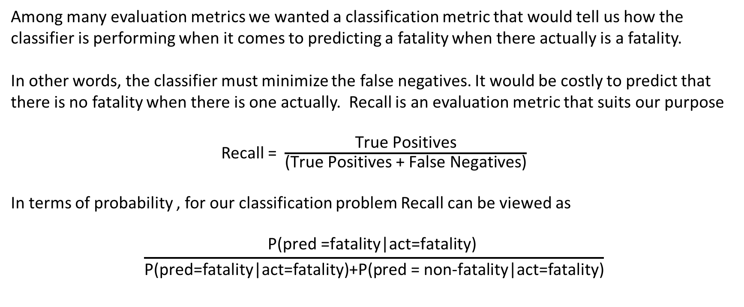
EVALUATION METRIC – RECALL
Among many evaluation metrics we wanted a classification metric that would tell us how the classifier is performing when it comes to predicting a fatality when there actually is a fatality.
In other words, the classifier must minimize the false negatives. It would be costly to predict that there is no fatality when there is one actually. Recall is an evaluation metric that suits our purpose
Recall = $\frac{\text{True} \text{Positives}}{\text{(}\text{True} \text{Positives}\text{ + }\text{False} \text{Negatives}\text{)}}$
In terms of probability , for our classification problem Recall can be viewed as
$$\frac{\text{P}\text{(}\text{pred}\text{ =}\text{fatality}\text{|}\text{act}\text{=}\text{fatality}\text{) }}{\text{P}\text{(}\text{pred}\text{=}\text{fatality}\text{|}\text{act}\text{=}\text{fatality}\text{)+}\text{P}\text{(}\text{pred}\text{ = }\text{non}\text{−}\text{fatality}\text{|}\text{act}\text{=}\text{fatality}\text{)}}$$

Slide 29
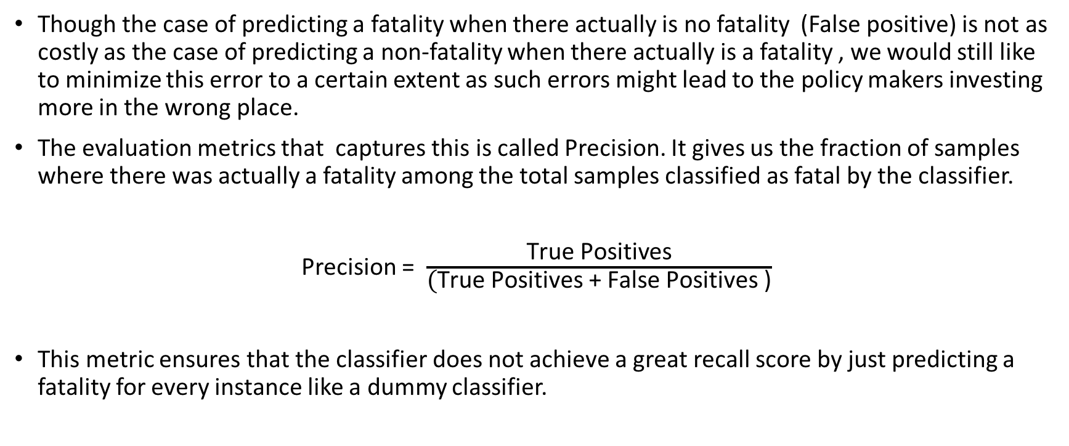
EVALUATION METRIC - PRECISION
Though the case of predicting a fatality when there actually is no fatality (False positive) is not as costly as the case of predicting a non-fatality when there actually is a fatality , we would still like to minimize this error to a certain extent as such errors might lead to the policy makers investing more in the wrong place.
The evaluation metrics that captures this is called Precision. It gives us the fraction of samples where there was actually a fatality among the total samples classified as fatal by the classifier.
Precision = $\frac{\text{True} \text{Positives}}{\text{(}\text{True} \text{Positives}\text{ + }\text{False} \text{Positives}\text{ )}}$
This metric ensures that the classifier does not achieve a great recall score by just predicting a fatality for every instance like a dummy classifier.

Slide 30
PERFORMANCE OF LOGISTIC REGRESSION WITH LASSO REGULARIZATION
0.846– Mean Recall score of the classifier on 5 fold cross- validation test
0.870– Mean Precision score of the classifier on 5 fold cross-validation test

Slide 31
RESULTS FROM LOGISTIC REGRESSION WITH LASSO REGULARIZATION
A collision that involves a pedestrian who is walking on the sidewalk (not on the road) is 7 times more likely be fatal. Possible explanation of this can be that motorists drove into the sidewalk due to rash driving.
When pedestrians were involved in collisions with motor vehicles, it turns out to be significantly fatal.
Alcohol consumption makes fatality 6 times more likely .
In terms of road surface, wet roads were more likely to cause driving fatalities than any other type of roads. Interestingly, this agrees with the fact that driving during rain was more prone to fatality.
Flooded roads played a massive part in a collision being fatal.
On the other hand, Rear end and Side swipe collisions had nearly no chance of being fatal.
When it was dark and street Lights failed to function, fatal crashes were more likely to happen.

Slide 32
THE MOST COMMON FACTORS LEADING TO FATALITIES AMONG ALL DIVISIONS
ROAD_COND_1H - No Unusual Condition
MOTORCYCLE_ACCIDENTY (the collision involved with a motorcycle)
ALCOHOL_INVOLVEDY (the collision involved a party that had been drinking)
MVIWB - Pedestrian (Motor Vehicle Involved With Pedestrian)

Slide 33
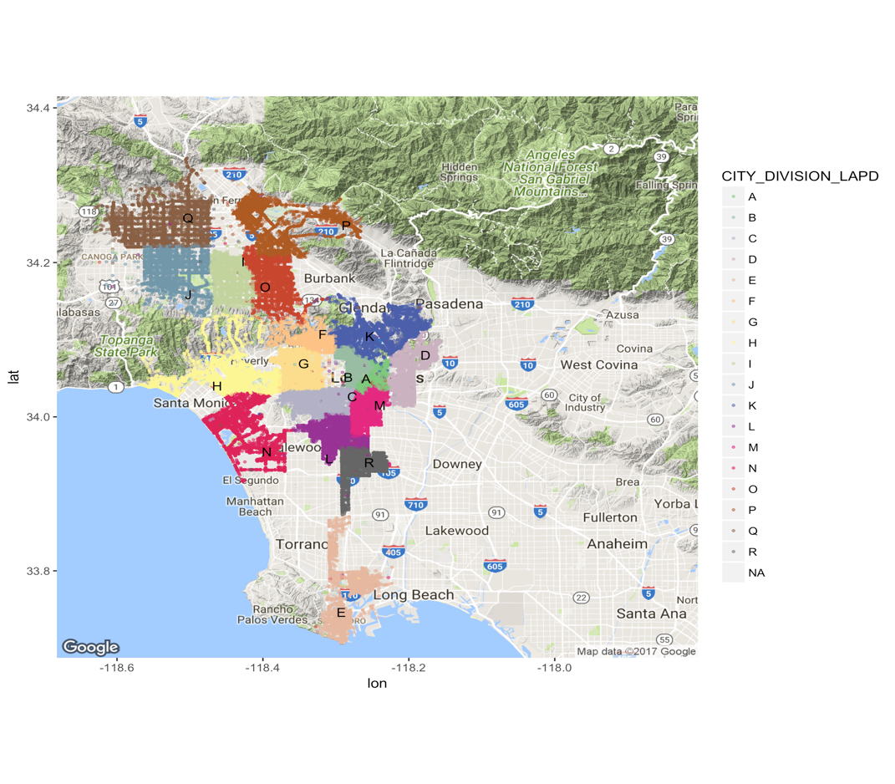
For some of LAPD divisions, there are special factors leading to fatalities
1. For division E, the collisions happened on Friday is more likely bring about fatalities; Violating traffic Signals and Signs is more likely bring about fatalities; Most of the fatalities occurred on SR 213 and SR 1. (State Route)
2. For division H, rear end collisions are more likely result in fatalities; Most of the fatalities occurred on SR 1(8), W SUNSET BLVD(8) and W OLYMPIC BLVD(6). (State Route)
3. For division K, the collisions happened on Wednesday is more likely bring about fatalities; Reduced Roadway Width is more likely bring about fatalities; Most of the fatalities occurred on N FIGUEROA ST(6) and LOS FELIZ BLVD(3).
4. For division L, Wind is more likely bring about fatalities; Most of the fatalities occurred on S WESTERN AVE(13) and S VERMONT AVE(7) W FLORENCE AVE(6) and W SLAUSON AVE(6).

Slide 34
For some of LAPD divisions, there are special factors leading to fatalities
5. For division N, the collisions happened in dark where there is no street lights is more likely bring about fatalities; Driving or Bicycling Under the Influence of Alcohol or Drug is more likely bring about fatalities; Most of the fatalities occurred on SR 1(5) and VENICE BLVD(5).
6. For division P, the collisions happened on road where it was flooded is more likely bring about fatalities; Most of the fatalities occurred on SAN FERNANDO RD(7) and FOOTHILL BLVD(7).
7. For division Q, the collisions happened on road with loose material is more likely bring about fatalities; Besides, when the automobile right of way is violated, fatality is more likely to happen; Most of the fatalities occurred on PARTHENIA ST(5).

Slide 35
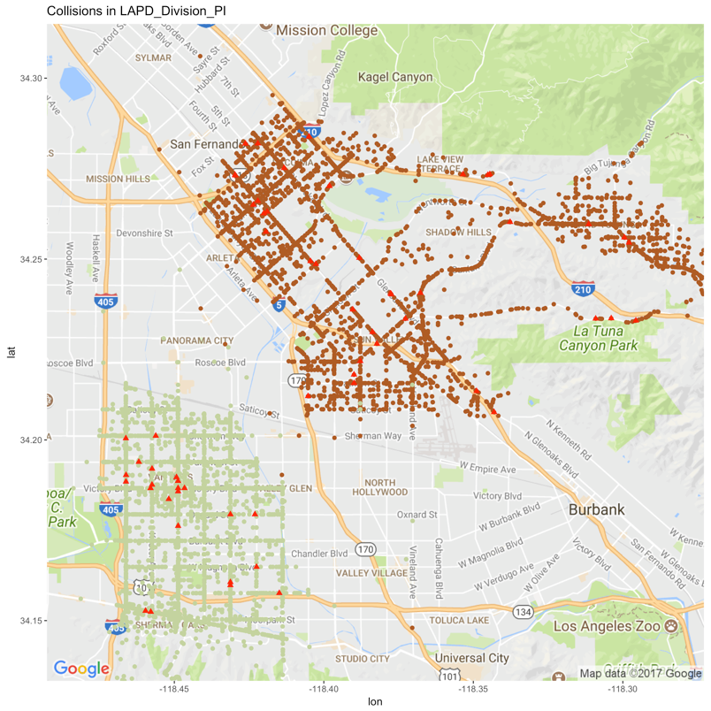
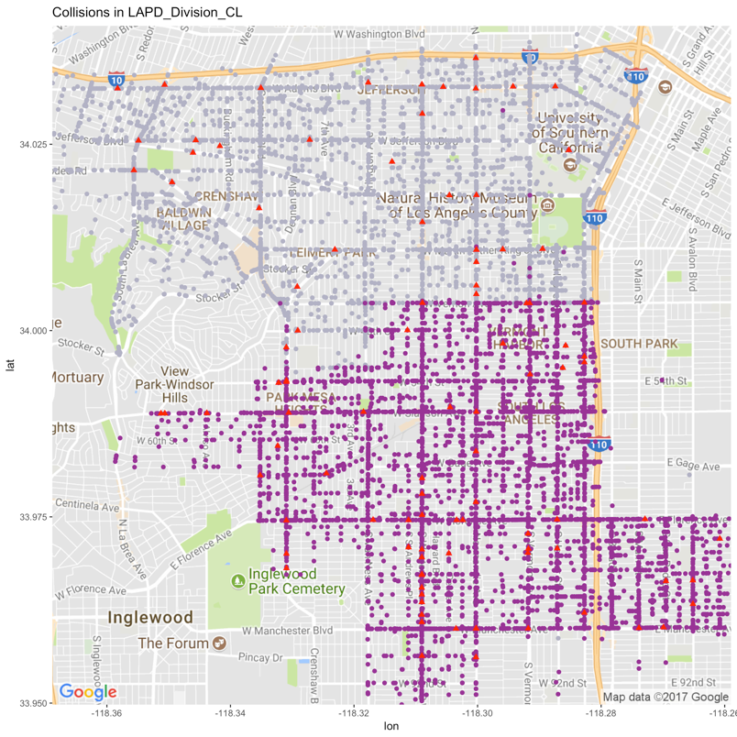
For division P and I, the collisions happened during dusk and dawn is more likely bring about fatalities;
For division C and L, the collisions caused by following too closely is more likely bring about fatalities;

Slide 36
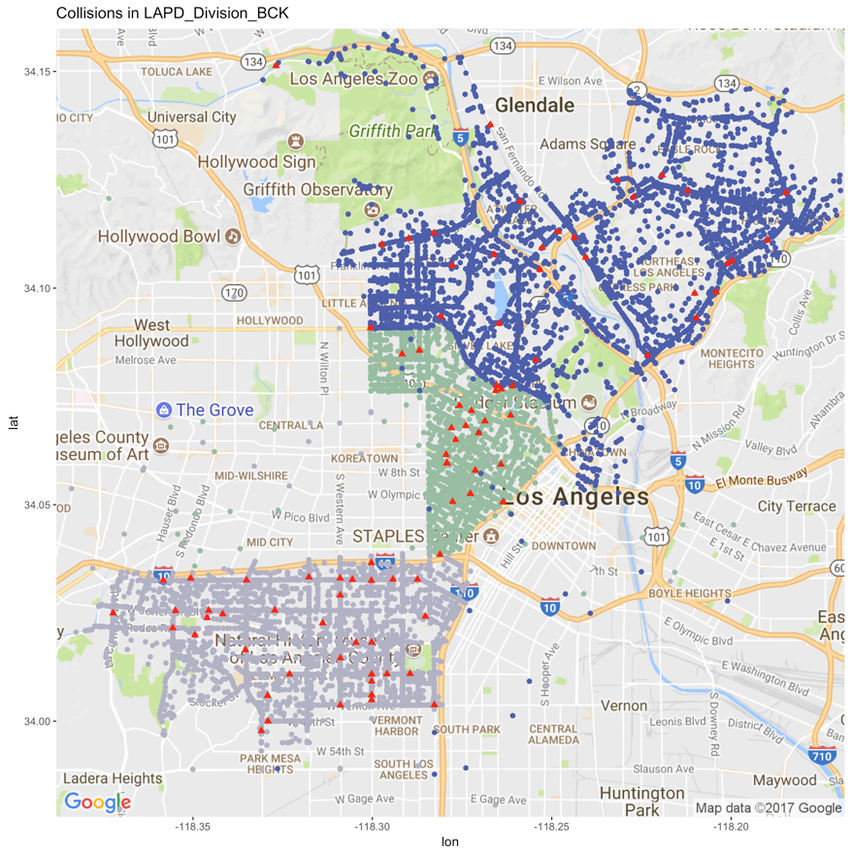
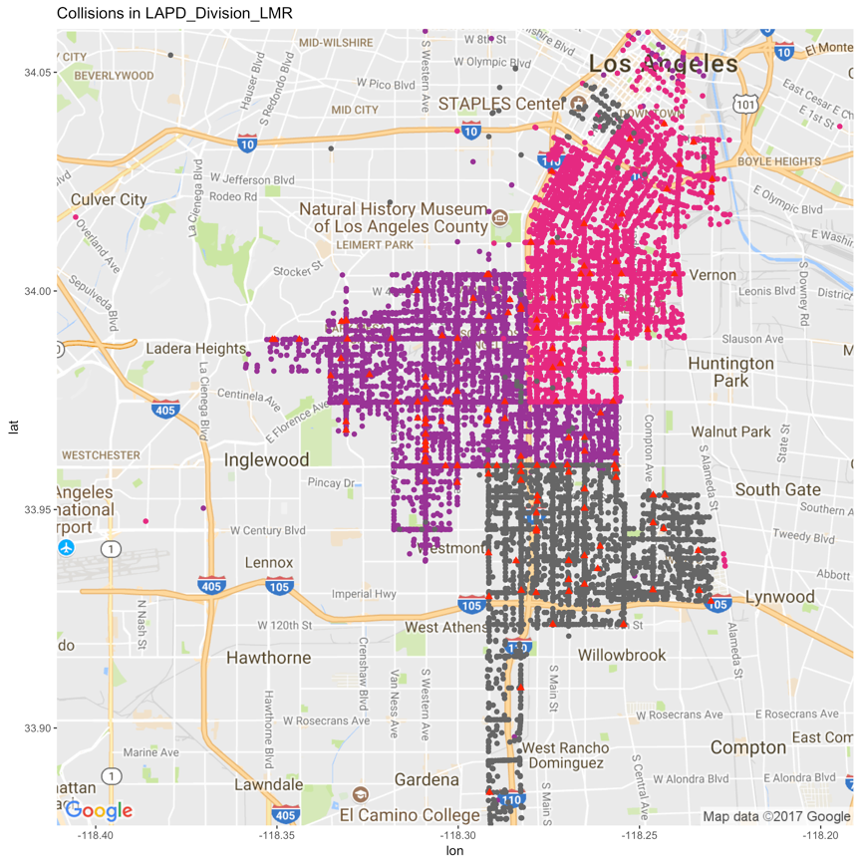
For division B, C and K, the collisions happened on Sunday is more likely bring about fatalities;
For division M, L and R, the collisions led by overturn is more likely bring about fatalities;

Slide 37
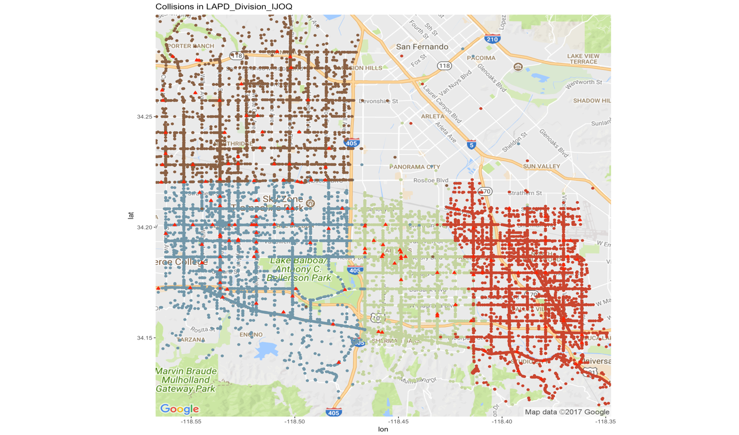
For division M, J, O and Q, a collision that involves a pedestrian who is walking on the road (including shoulder) is more likely be fatal.

Slide 38
RANDOM FOREST CLASSIFIER
A random forest is an ensemble of decision trees, which individually predict the class label and output the majority vote among all trees.
Each decision tree at each stage randomly chooses a subset of features, and then selects the best among those features to create a split in the data. This helps overcome the problem of overfitting in an individual decision tree.
For our problem, a grid search was performed to find out how many decision trees to fit and maximum depth of each tree. It was found that a 100 decision trees with maximum depth of 9 performed best on recall and hence was chosen for predicting fatalities.
Our Random Forest model works on the same set of features as the Logistic Regression model that was elaborated in the earlier slides.

Slide 39
RESULTS FROM RANDOM FOREST MODEL
0.92– Mean Recall score of the classifier on 5 fold cross- validation test
0.96 - Mean Precision score of the classifier on 5 fold cross-validation test
We see that the random forest classifier has outperformed the logistic regression model.

Slide 40
RANDOM FOREST - MOST IMPORTANT FACTORS
The most important features to build the random forest model, that is the features that created the purest of splits based on “Gini index” turned out to be the involvement of a vehicle and pedestrian and alcohol consumption
In fact, it turns out most of the important factors are in agreement with logistic regression’s result which further emphasizes the significance of these factors
The top 5 factors
Motor vehicle collision with pedestrian
Alcohol consumption
Pedestrian not in road during collision
Wet Roads
Rain

